Slide 1

Cooloola Waters Retirement Village
Upcoming Events 2025
Prepared by Marilyn Bee 0401410883 – Pls advise any alterations asap.

Slide 2

Birthdays – Sept/Oct 2025
September Birthdays (remaining
Morry Bourke – Unit 9 – 22nd Sept
Ann Jenkins – Unit 75 – 26th Sept
Lorraine Burke – Unit 12 – 28th Sept
October Birthdays
Partick Ryan (Darcy) = Unit 36 – 3rd Oct
Barry Shearing – Unit 50 4/10/1948
Diann Bourke – Unit 9 – 9th Oct
Daryl Watson – Unit 85 – 11th Oct
Beryl Leggat – Unit 33 – 11th Oct
Alice Gardiner – Unit 7 – 13th Oct
Beryl Corso – Unit 15 – 14th Oct
Tricia Shipley – Unit 69 – 19th Oct
Adrienne Evans – Unit 67 – 19th Oct
Reg Cole – Unit 79 – 20th Oct
Geoff Johns – Unit 42 – 21st Oct
June Griffiths = Unit 43 – 28th Oct

Slide 3
Upcoming New EVENTS and Date Claimers
Event | Date | Time
New Event – Wheelie Club - Bikes, Wheels & Walkers Club - Twice Weekly - Difficulty – Easy to Challenging (you choose) | Every Saturday Every Monday Meet at Club House | 8.00 am 4.00 pm Phone Liz 0400 865 855 – Unit 72 for details
Free Movie Matinee - Cowboy Movie – BYO Drinks and snacks. Choose your own movie | Every Sunday | 4.00 pm
Bible Chat and Prayer | Club House | Friday 3.45 pm for cuppa for 4.00 – 5.00 pm
EOM BBQ – BYO Everything | Sun 28th September | 12 noon
Tuesday Morning Melodies with Trevor (Tickle the ivories) -Sing, Laugh and enjoy | Tues 7th October | Morning Tea Provided
Tin Can Bay Sunset Cruise - $25 | Thurs 9th October | 4.00 pm
Residents Committee Meeting | 11th November | 10.00 am

Slide 4
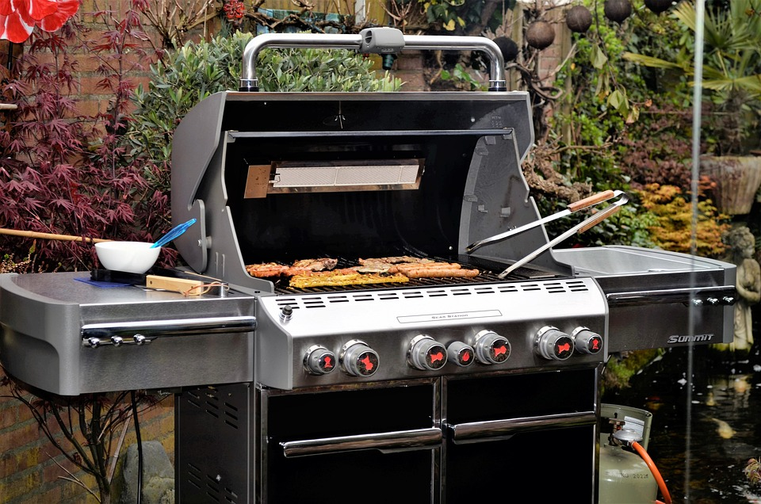
End of Month – EOM – VILLAGE BBQ
Next BBQ day - Sun 28th Sept - Noon at Poolside
BYO FOOD
BAR IS OPEN

Slide 5

Morning Melodies with Trevor – Tuesday 7th Oct. 10.00 am
Come along, listen, sing and laugh with your mates
Morning Tea provided
Free
Just come along to enjoy the friendship and music
Take advantage of our wonderful new asset

Slide 6
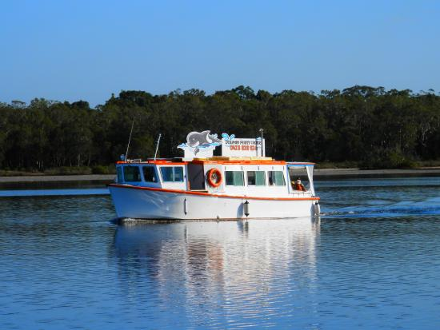

Sunset Cruise – Tin Can Bay – Thurs 9th October – 4.00 pm
$45 per Head – BYO Snacks and Drinks
Tea and Coffee Supplied
Numbers required for the trip – 20 – 25 Pax
Cruise is approximately 90 minutes
Cruise is subject to numbers, tides and weather
Book your place on board by adding name to the list and paying money into the locked box as usual in an envelope with your name on front.
This Photo by Unknown Author is licensed under CC BY-SA

Slide 7



Oktoberfest – Sat 18th October
5.00 pm
Cost – Residents $10 – Other $12
German Dress Up
Bring your own Beer Stein
Lunch – German Sausage on Buns, Onions and all the trimmings. Apple Strudel & Custard
Raffles Galore, Money Board $30, $20, $10
Only 50 places catered for.

Slide 8




OCTOBER’S RESIDENTS MEETING
Postponed until 11TH Nov - 10.00 am
2025/2026
Fiona Hansen – President – Phone 0423 948 031
John Bee – Secretary – Phone 0401 467 733
Sakina Oakley – Treasurer – Phone 0438 685 701
If you are unable to attend and/or speak at the meeting, please submit any apologies as well as any questions, proposed motions, good comments, or complaints in writing into the mail-box either anonymously or identified before meeting date.
This helps the committee to prepare the agenda for discussion and gives residents a chance to be involved.

Slide 9

Free - DIY - Movie Matinee – Each Sunday 4.00 pm – Choose your own movie (See Wally) and BYO
BYO. Sit in comfortable chairs in the pool room, bring some friends and watch a movie. Movies available from Wally or BYO.
If you need help with technology – call John Bee
-------------------------------------
John Bee – Unit 76 – 0401 467 733

Slide 10
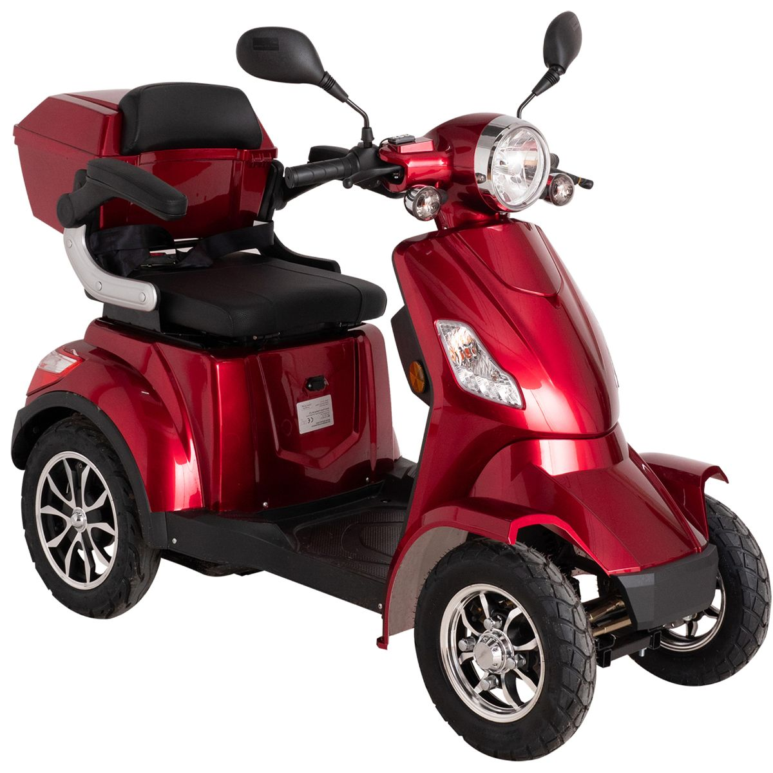

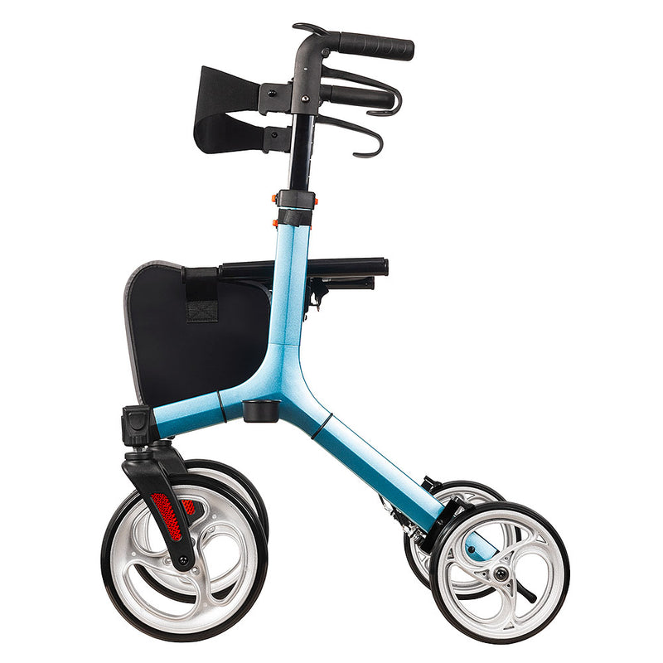

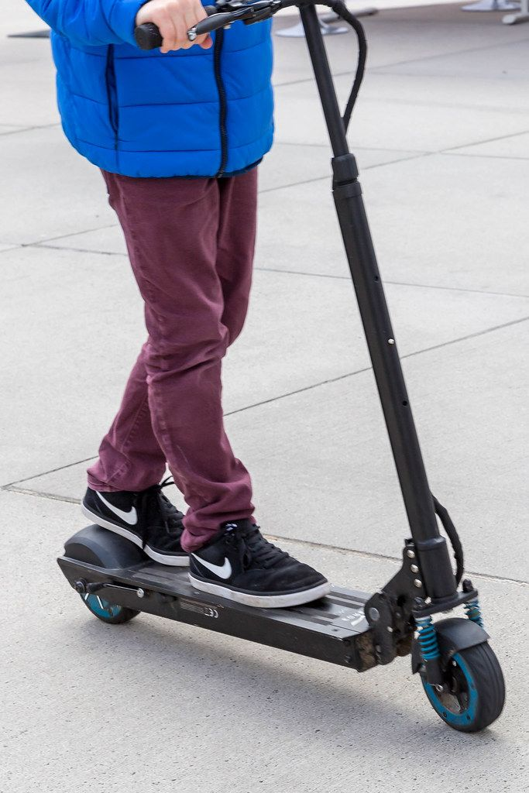

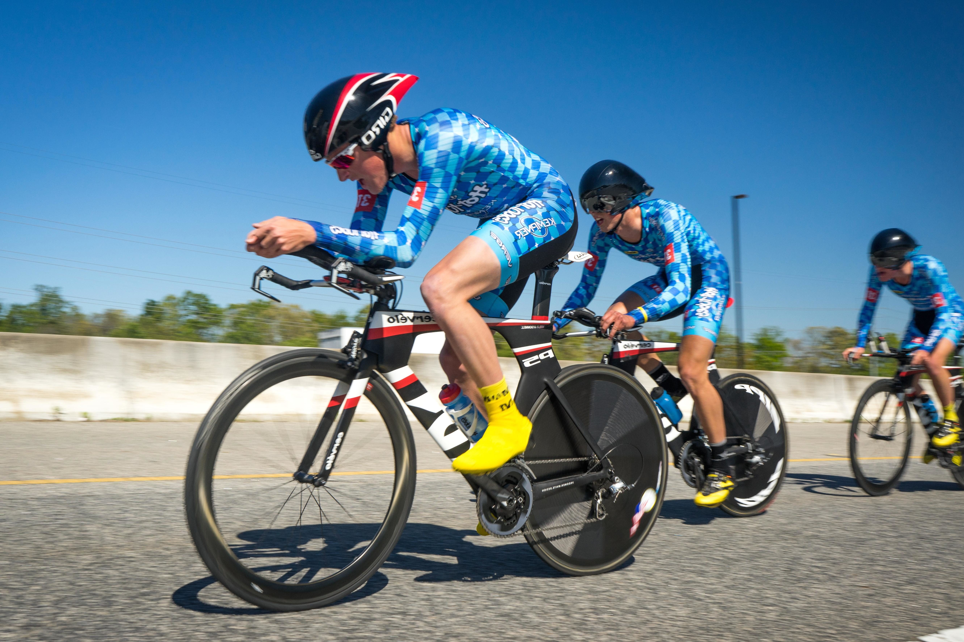
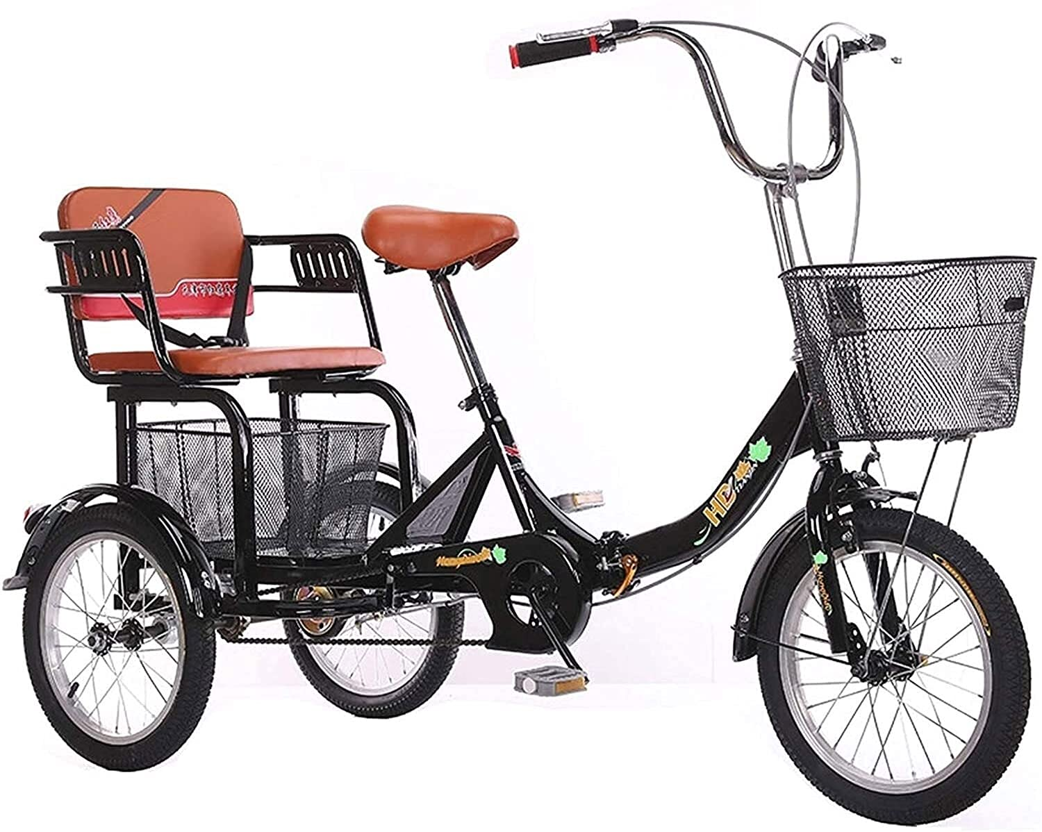
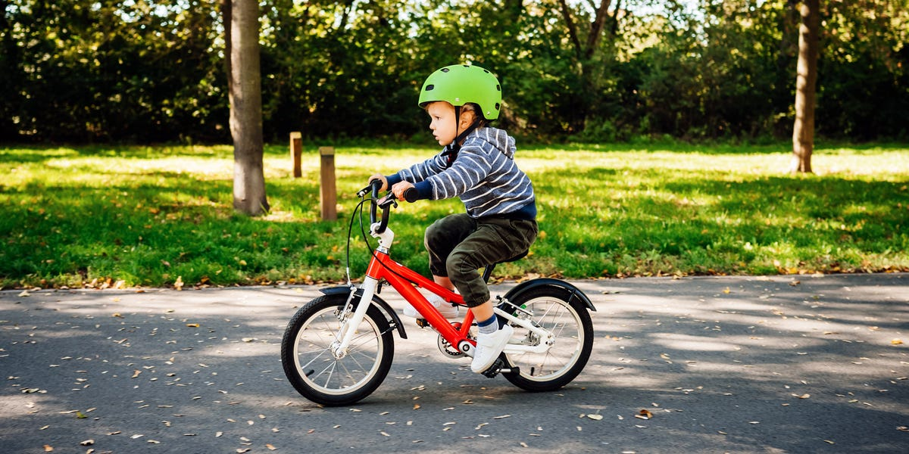
CWRV Wheelies Club – Saturday 8.00 am and Monday at 4.00 pm from Club House
Coordinator – Liz – 0400 865 855
# Get some fresh air
# Keep safe
# Slow or distance – your choice
# Crab Creek and back or further
# Faster wheels go further
# All leave together – but gradually arrive back for morning tea at Club house
This Photo by Unknown Author is licensed under CC BY

Slide 11

CMRV – Book Club – 3rd Thurs – 16th October – meet at club house 11.45 for car pool to venue 12.00 for Lunch
Monthly Meeting with a 11.45 car pool at Club House for lunch at 12.00 noon –usually monthly on 3rd Thursday
Limited to 8 members
Subscription $20.00 per annum donated to library for books
Please phone Bron (Book Club Organizer) for details 0427 092 140. Details to be confirmed.

Slide 12

Bible Chat and Prayer
Commencing
Every Friday 3.45 pm
Led by Residents Jeff Winterburn (Salvation Army Minister of Religion) & Liz Winterburn (Chaplain)
Afternoon Tea provided 3.45 pm
With chat, prayer & questions 4.00 pm – 5.00 pm
Friendly discussion
Phone 0400 865 855 for inquiries

Slide 13






Place your Eligible 10c containers here
It is stated on the container if it is eligible
Plastic containers
White Lid
Glass bottles/jars
Do not crush cans
Please, Please NO other Rubbish
Recycle Bin
All funds will be used towards
Cooloola Waters Retirement Village
Internal fund raising Projects
LOOK FOR BINS AND SIGNS AROUND THE VILLAGE – Phone Daryl Watson 0418 333 739 for any enquiries

Slide 14
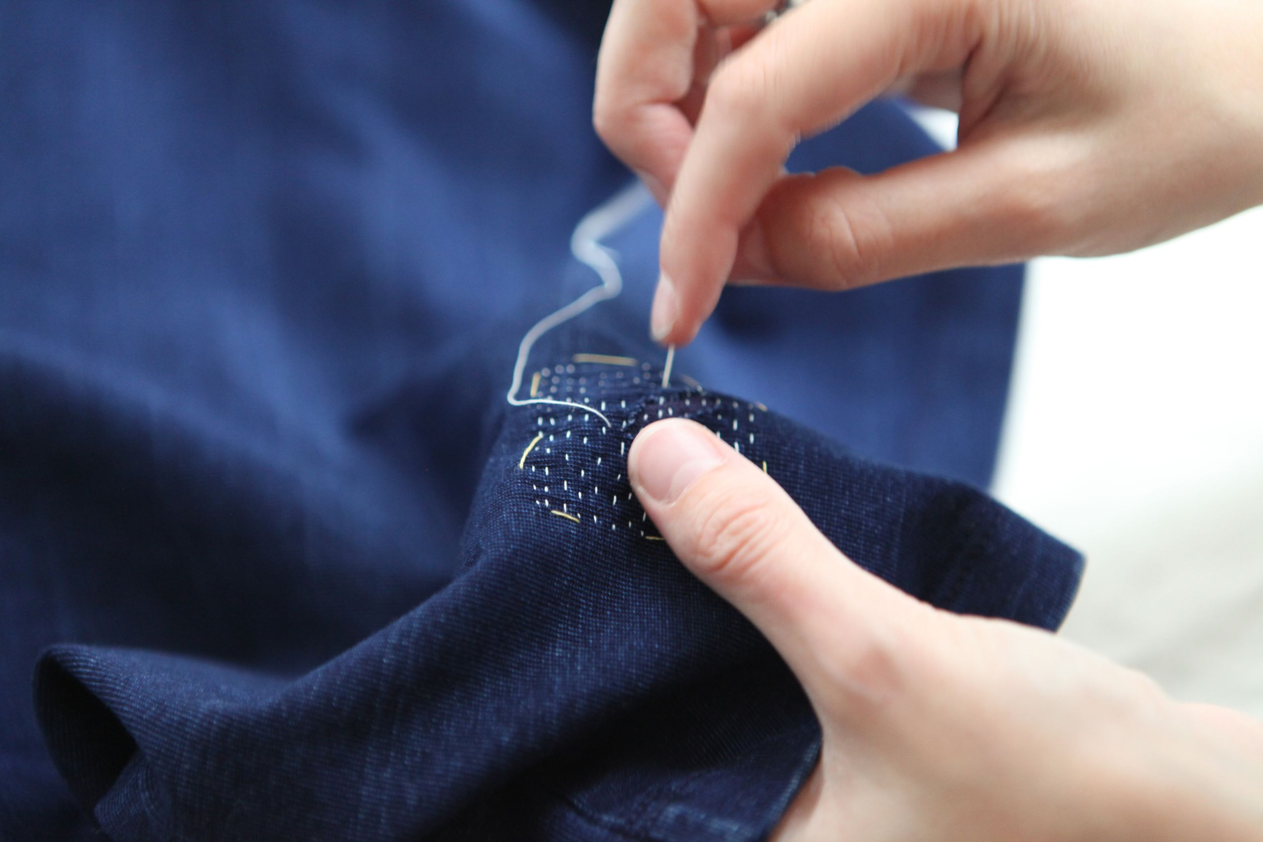
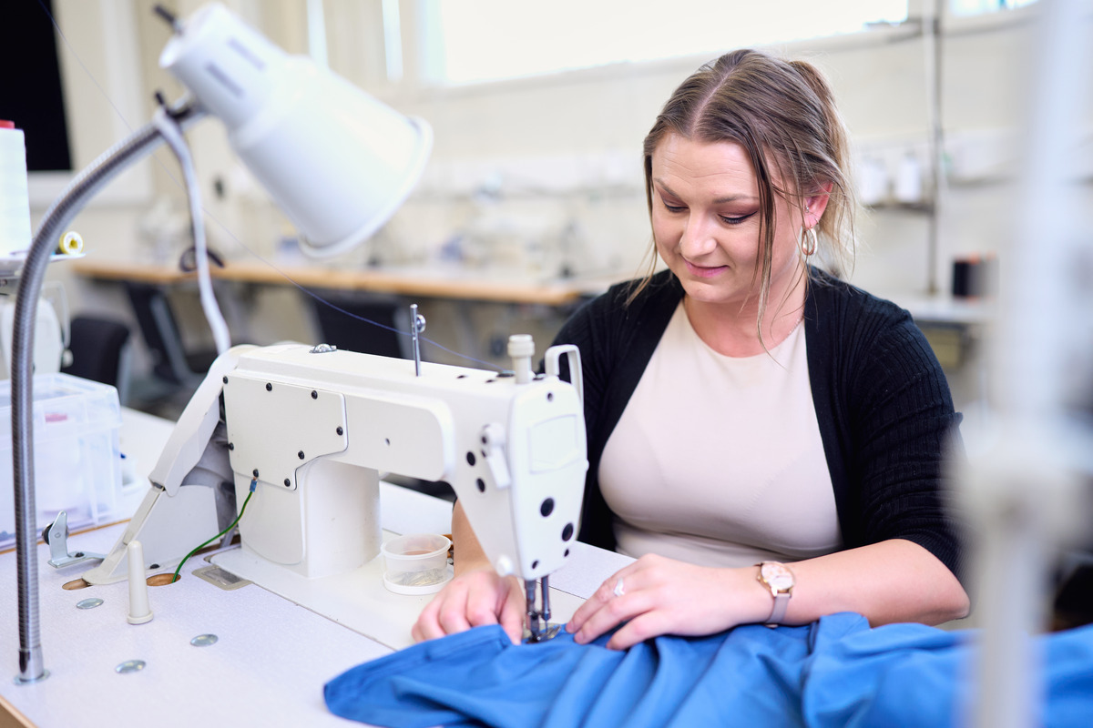
Liz’s Small Mending – hems, buttons etc.
Liz Winterburn is offering a service to complete small and simple mending. Liz’s work is voluntary but she asks that you make a donation for the service to the CWRV Residents Committee.
Liz is in Unit 72 and her phone number is 0400865855
This is a great service that is very welcome. If you have work done, please help by making a donation to the Residents Committee which will help residents with future needs including storage and/or dog facilities etc.

Slide 15


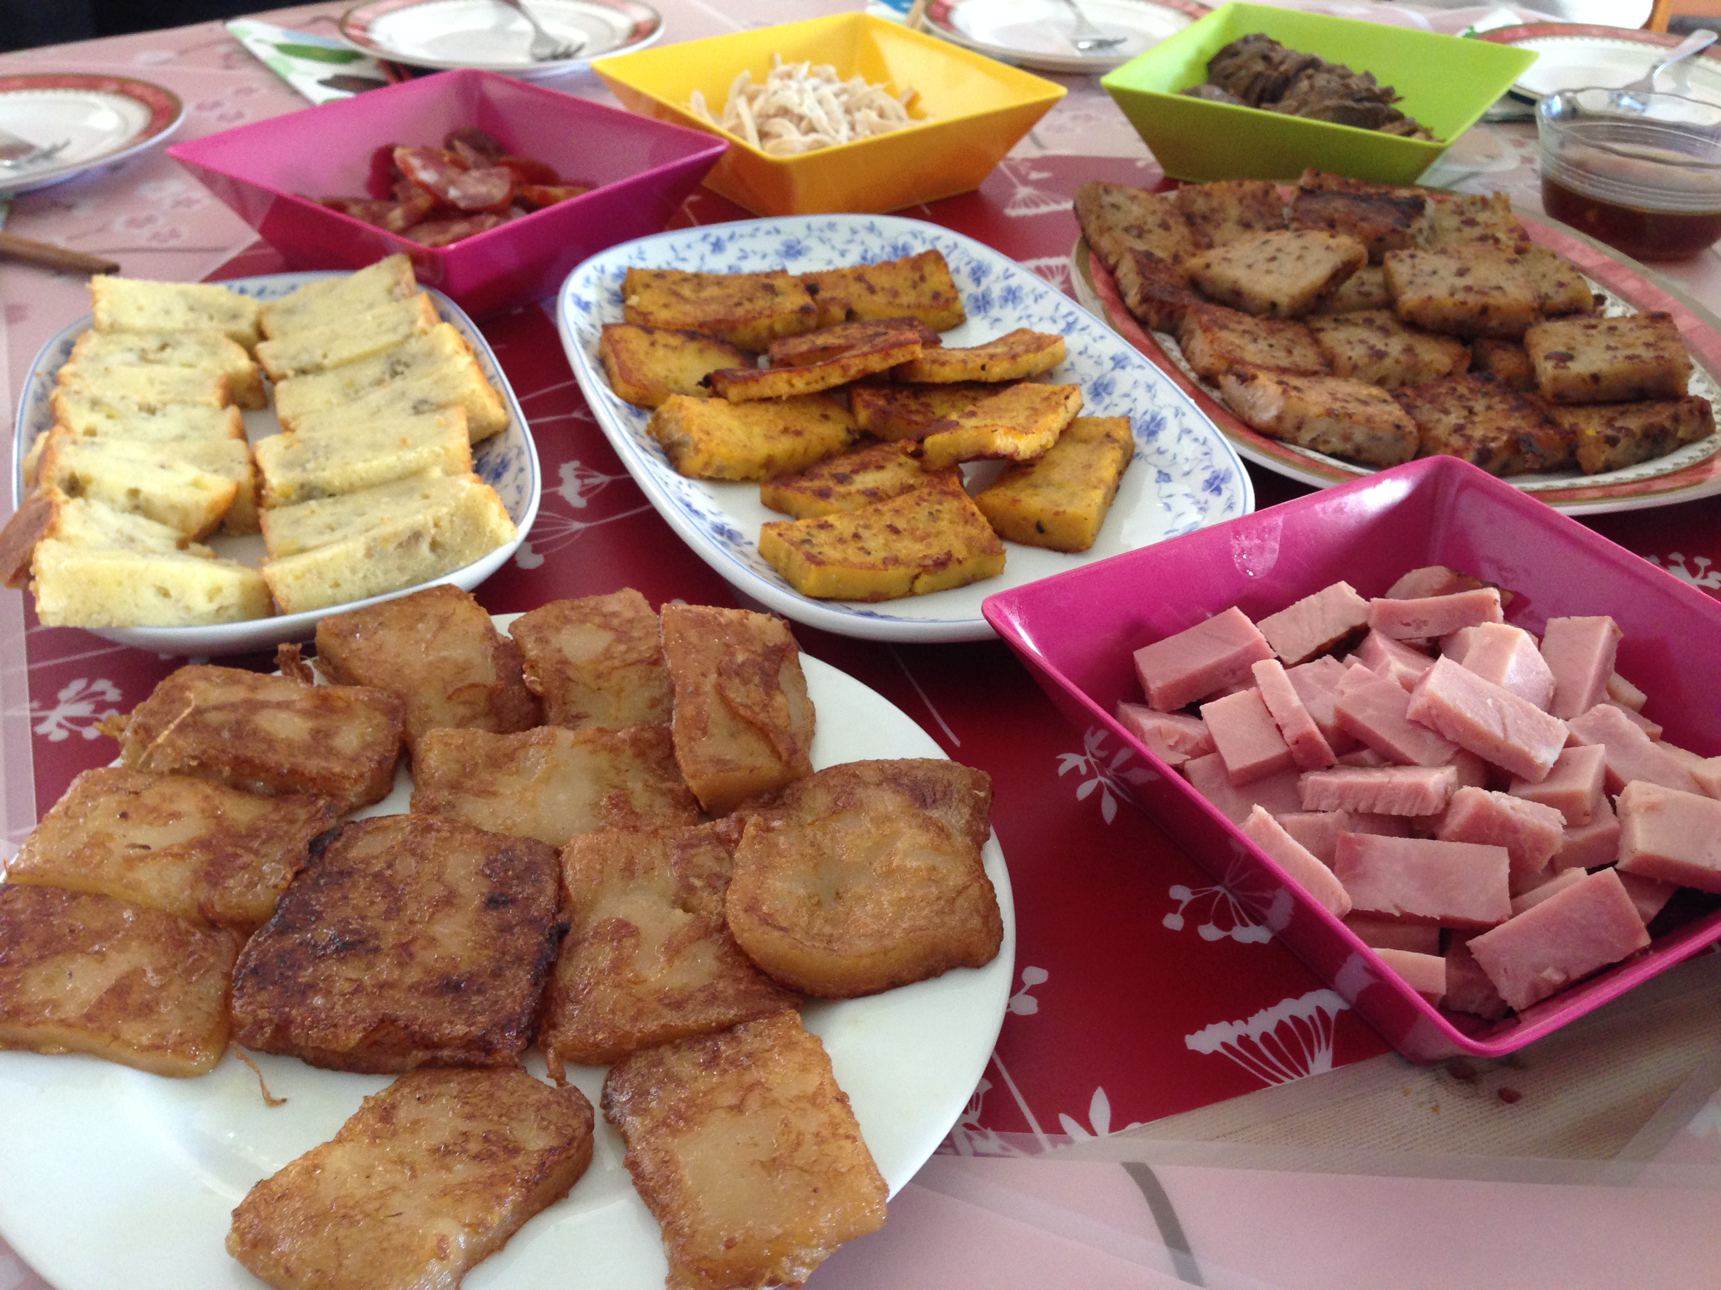


HAPPY HAPPY HOUR
Every Wed 4.30 pm
CWRV - Residents and visitors
Bring a plate of finger food/snacks to share
Weekly catch up of friends
Good time to keep in touch - to make and keep friends.
Join Wine Club – 10 glasses for $15 or BYO
This Photo by Unknown Author is licensed under CC BY-SA

Slide 16

REGULAR SIMPLE EXERCISE
ALL WELCOME - COME AS YOU ARE - NO FUSS – ALL FREE. Sessions are being run by Angie, Ann and others while Marilyn is in Hospital. Thanks to them and they will keep you moving.
If you are like me – you really need to do some regular - simple - seniors and beginners - exercise but need some like-minded friends to keep motivated. Ideas and Help is appreciated.
MONDAY – CHAIR YOGA + BALANCE – 9.00 am
WEDNESDAY – TAI CHI/QI GONG– Mini Zumba 9.00 am
FRIDAY – RESISTANCE – STRENGTHENING – 9.00
OTHER RELEVANT CLASSES MAY ALSO BE ADDED TO PROVIDE VARIETY AND INTEREST.
PLEASE JOIN OUR GROUP IN THE CLUBHOUSE FOR ANY OR ALL OF THE SESSIONS WHICH USE OUR SMART TV TO UTILISE SOME OF THE BEST TRAINERS FOR OUR CLASSES AS WELL AS PROVIDING A VARIETY OF ACTIVITIES.
PHONE MARILYN – Unit 76: 0401 410 883 IF YOU WISH TO ASK ANY QUESTIONS OR JUST COME ALONG.

Slide 17

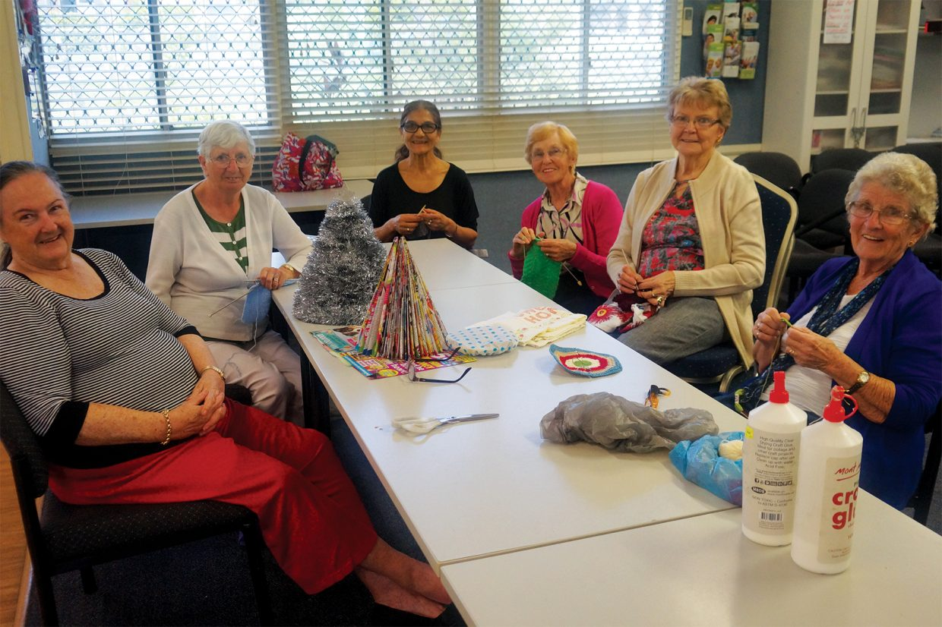
CWRV – Craft Group
Every Thursday Morning 9.00 am onwards
Bring your craft
Have a cuppa and chat
Every week

Slide 18
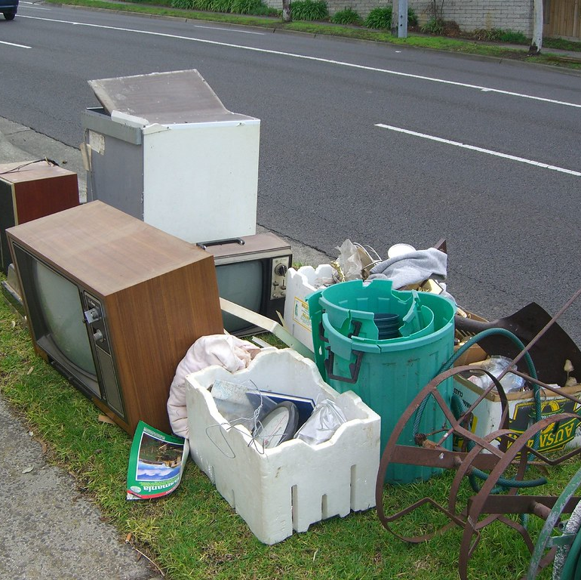
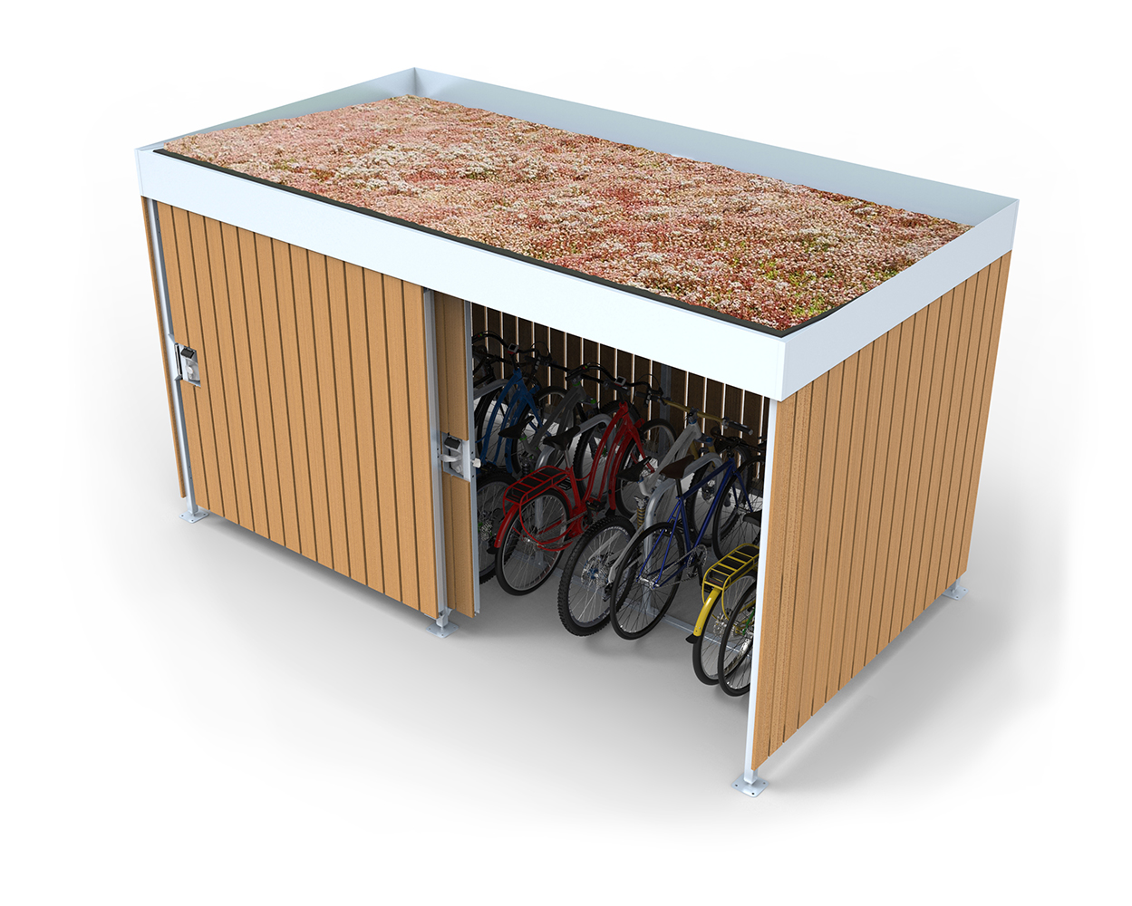

Rules for Residences Larger Items Rubbish Tip Run
1. Bike Shed in Driveway IS NOW PERMANENTLY UNLOCKED to collect UNWANTED PERSONAL ITEMS.
2. UNWANTED items can be put in the Bike Shed WHICH will BE TAKEN TO THE TIP AS NEEDED
4. Office and staff cannot provide help for this. please ask a friend TO HELP YOU MOVE ITEMS IF NEEDED or just take to the tip yourself.
3. To reduce tip costs for the village – items in this shed may be taken by others personal use and please keep the items to a minimum to reduce tip costs.

Slide 19
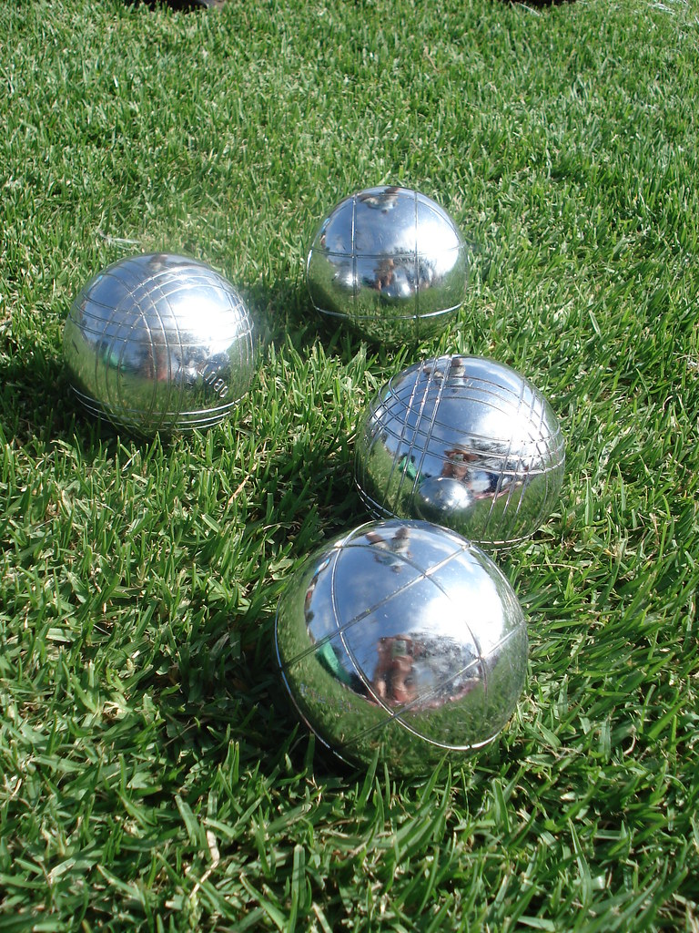

Petanque or Bocce on the grass in front of Club House – Friday 3.30 pm onwards. BYO drinks/snacks if you wish. Everyone welcome.

Slide 20

Croquet – Tues Afternoon at 3.00 pm and Sunday 9.30 am
Croquet on Tuesday at 3.00 pm. Also often a casual game on a Sunday morning 9.30 am
Beginners and advanced welcome.
Join B2 (Barry) on the lawn next to the swimming pool – Tuesdays for coaching. Or start a game yourself anytime.

Slide 21
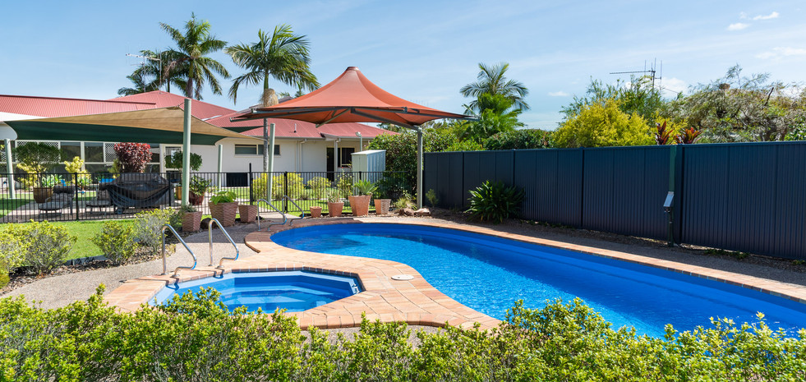
Clubhouse Protocol
The clubhouse is for the use of everyone.
Please be respectful and leave things as you find them.
All dishes should be washed, put away, or rinsed and placed in the dishwasher.
Dispose of food in the sink incinerator, not the kitchen bins.
Make yourself familiar with where things go and how they work.
Biscuits, tea, and coffee are available to residents when participating in activities within the clubhouse. Please replace lids on biscuits etc.

Slide 22

Poets Corner – Tin Can Bay Library
9.30 – 10.30 Second Saturday every month

Slide 23
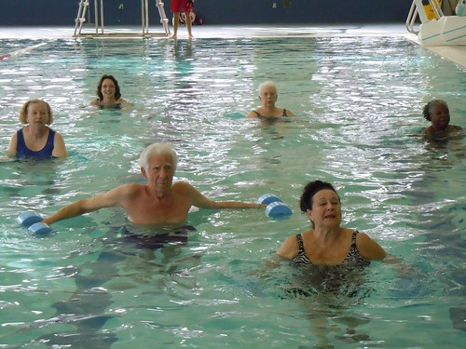
Aqua Aerobics – with Travis in Heated Pool
Free for Residents - Keep checking computer slide show as times may have recently changed.
Now 3 classes per week at CWRV
Tuesday - 4.15 pm
Tuesday - 5.15 pm
Thursday – 8.00 am
Excepting Public Holidays
Other classes are also available at the Public Pool. Ask Travis as these require to pay to get into pool

Slide 24

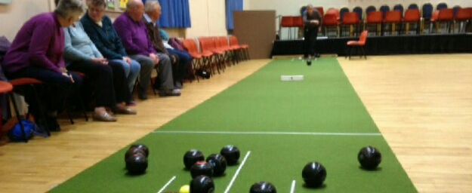
Indoor Bowls – Monday 10.00 am
The mat and bowls are laid out in the clubhouse for regular use. This has become a favourite weekly event and could be bi-weekly if required. The Indoor Bowls game can also be a good alternative to Bocce or Croquet if raining.
New proper lawn bowls have been received and are ready for play.
If interested please contact our keen indoor bowls player - Reg - Unit 79 PH: 0415 556 936 or drop in to see him.

Slide 25

Jig Saws
Jigsaws are available on the library shelves for anyone to use.
There is a permanent jigsaw in the club house (near the kitchen) for everyone to complete. This can be changed to another once completed.

Slide 26

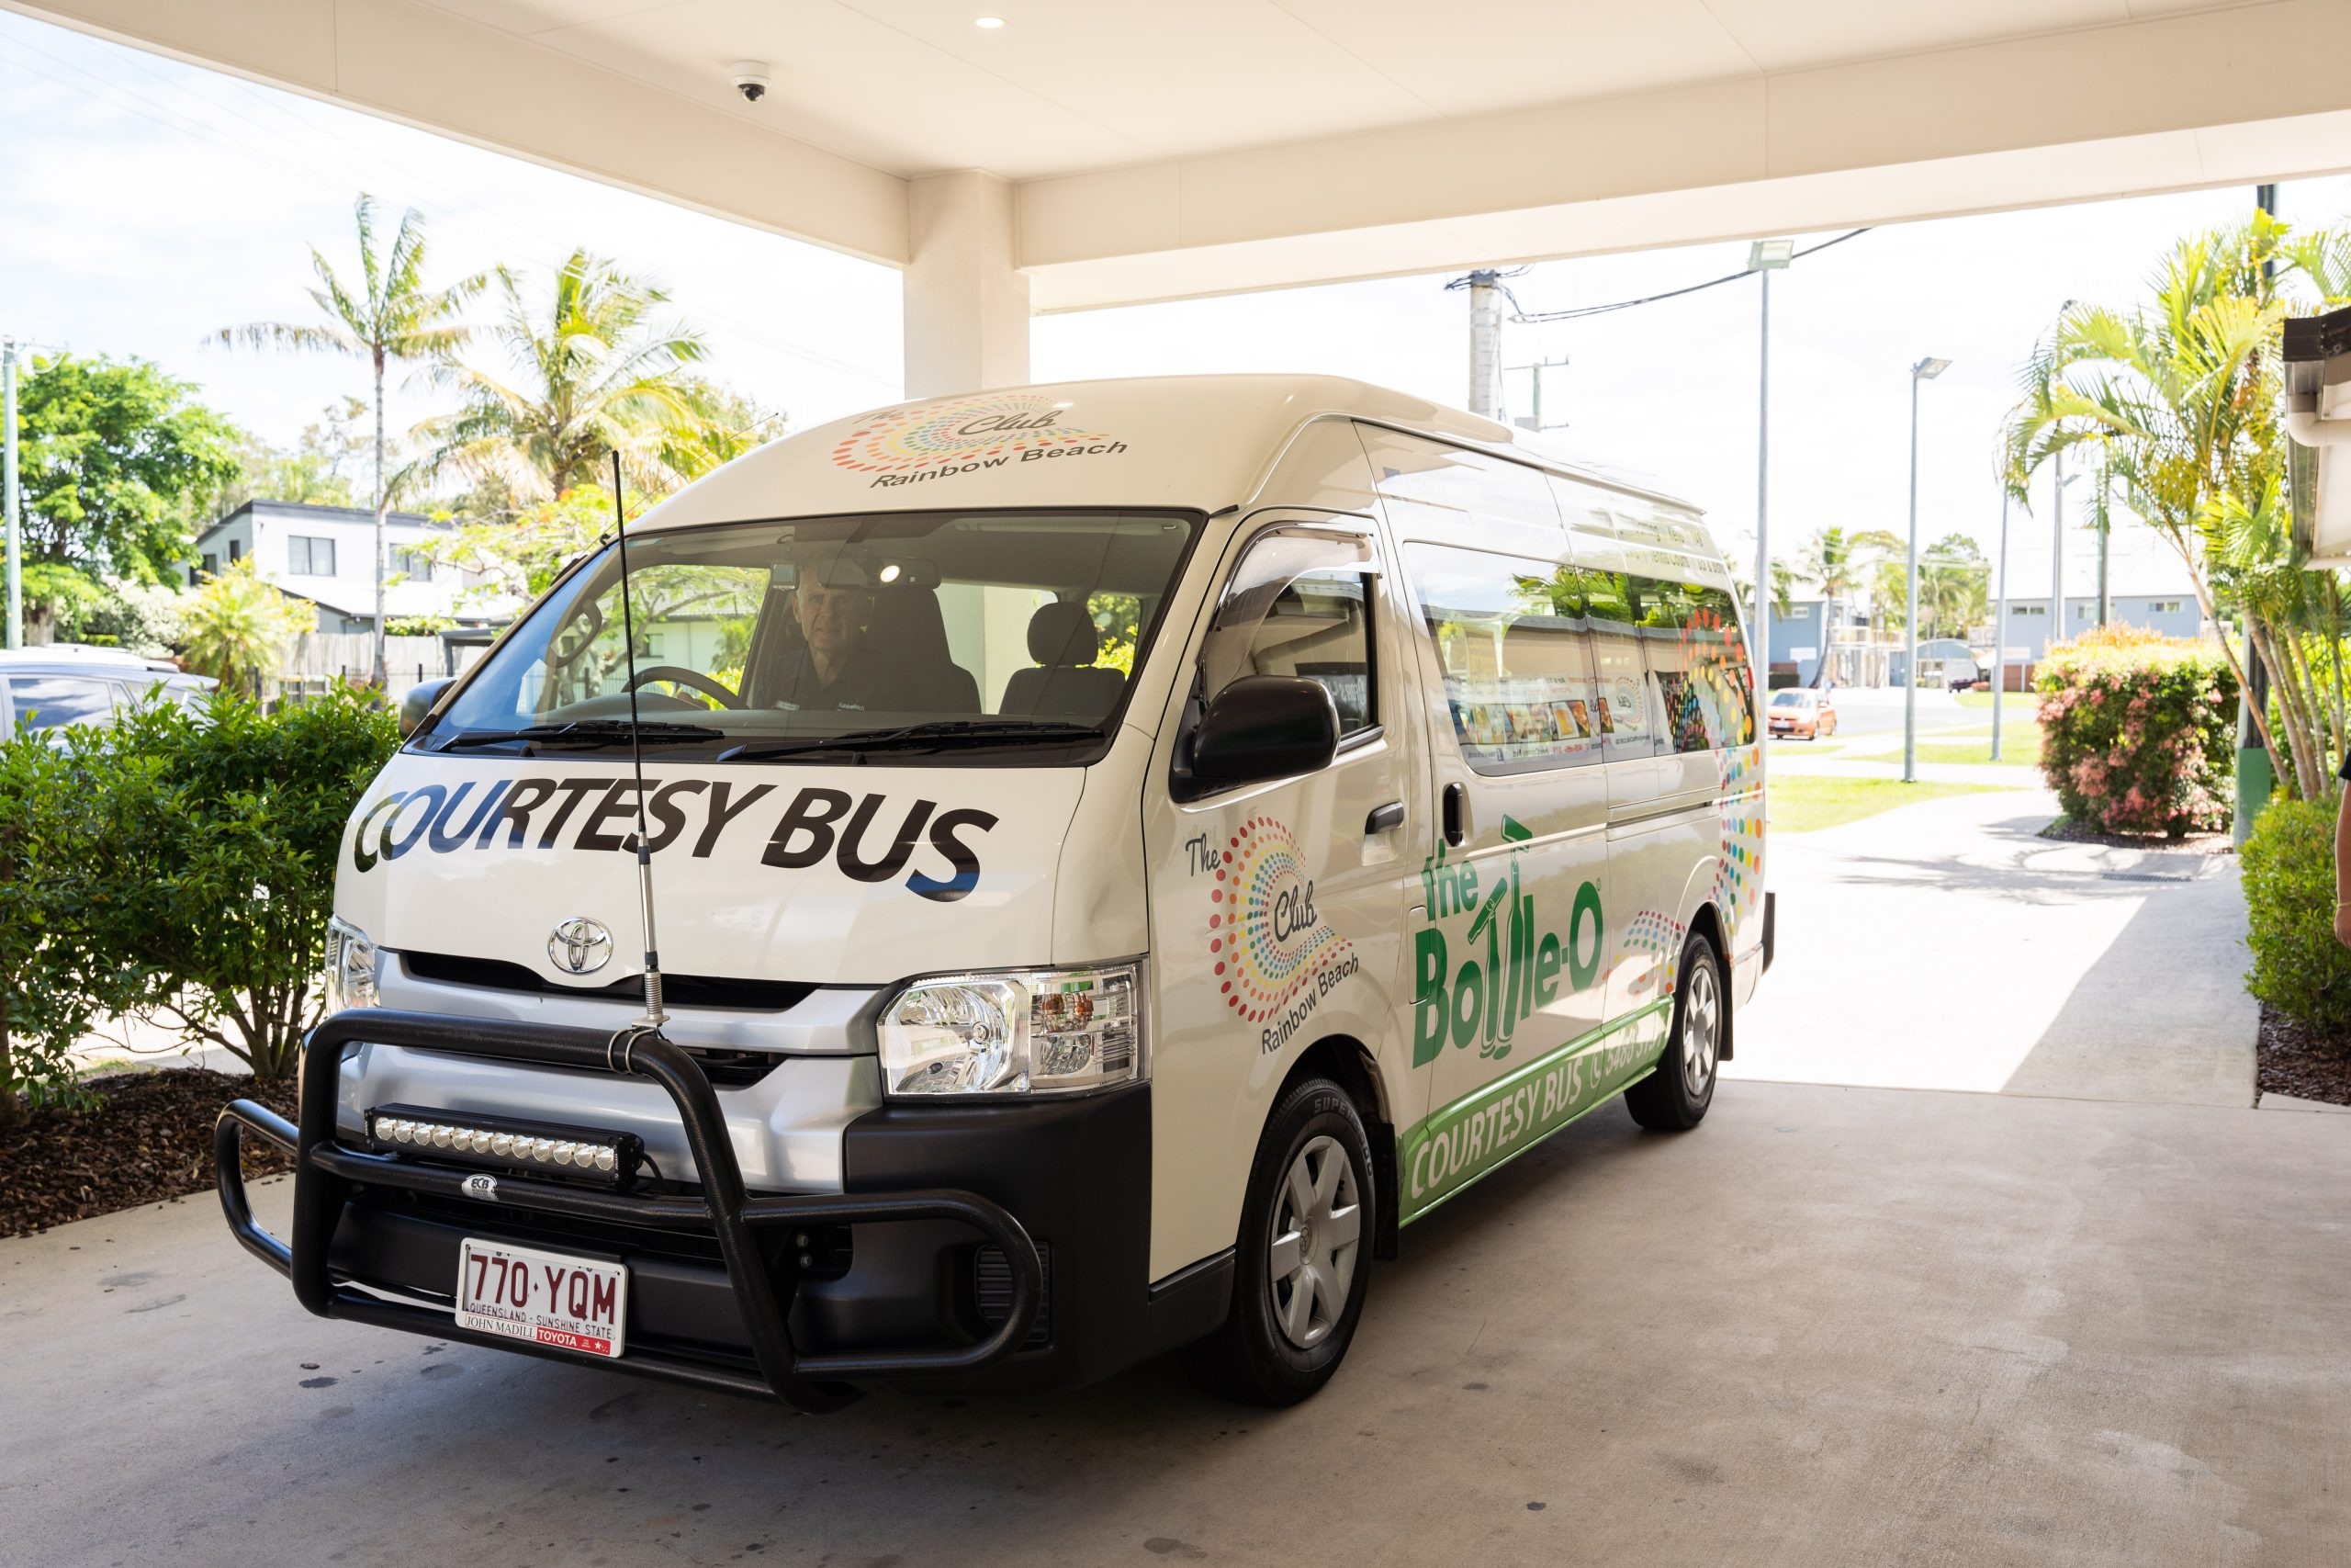


Rainbow Beach Sports Club – Courtesy Bus
Free Pick up and return by arrangement
Ph 5486 3191 – available for visits, meals
ALSO
Regular Bingo Bus – Every 2nd *Tues*
Leaves Tin Can Bay 8.30 am. Beside IGA, Groper Street
Eyes Down – 9.30 am
Leaves Rainbow Beach Sports Club 1 hr after final “BINGO”

Slide 27

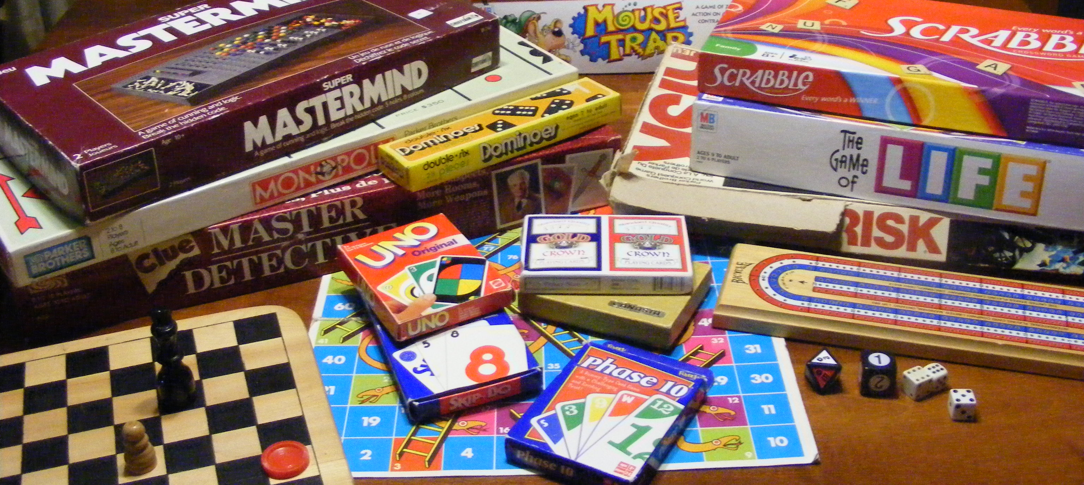
Various Board Games
All are available in the closet next to the stage in the dining room.
Help yourself – enjoy with friends at home or if you like - join the other mahjong and rummyo players and make a games afternoon in the Club House. Most afternoons – see schedule. Don’t be shy.
Afternoon tea and cake can be supplied if we get a regular group of 10 for players of any of the activities in the Club House.
We encourage everyone to feel at home to enjoy all of the offerings available and enhance your time spent here. Champions or newbies all welcome.

Slide 28
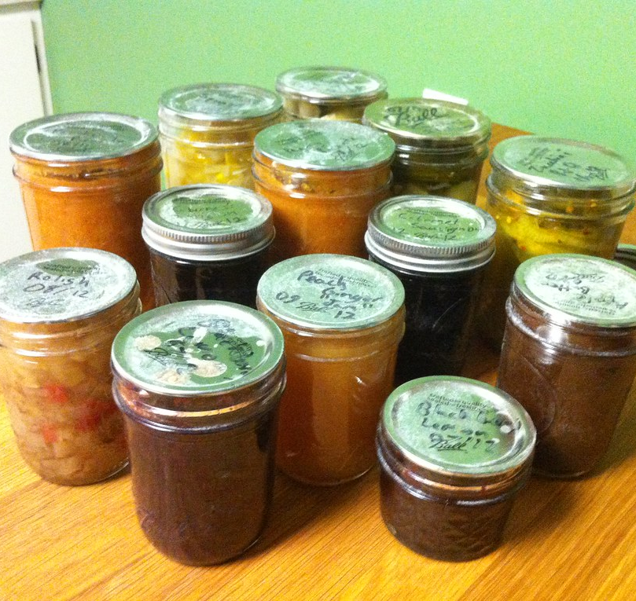
Jams, Pickles and Sauces
Kindly made by Residents of CWRV– now $4
Kindly hand made by the residents
All available in the Club House near reception.
Cost is $4. Pls put money in container near jars and pls return jars when finished.
Funds go to the residents fund.
-
For Sale

Slide 29

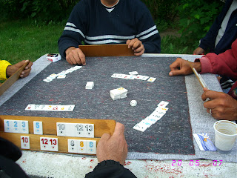
“Clubhouse Rummyo”
1.00 pm – 3.00 pm
Weekly on Tuesdays & Saturdays
Beginners and Advanced
Meet neighbors –have fun
This Photo by Unknown Author is licensed under CC BY-ND
Learn new skills – Many other board games are also available – Join us for afternoon tea, chat and laughter.

Slide 30
Repeating Morning Free Events
Monday | Tuesday | Wednesday | Thursday | Friday | Saturday
9.00 - 9.45 Chair Yoga and Balance with Marilyn. Choose your level 10.00 am (Snooker/Pool) with the Lads 10.00 am Indoor Bowls in the Club House | 2nd Tues 10.00 Residents Meeting (EXCEPT Jan) Look for confirmation of time and agenda | 9.00 – 9.45 Tai Chi/Qi Gong Beginners and a Little Zumba with Marilyn 10.00 (Snooker/Pool) with the Lads | 8.00 am Aqua Aerobics – heated pool 9.00 am Craft Group – bring your craft – | 9.00 – 9.45 Resistance Training Seniors/ Beginners and 10 min Zumba with Marilyn 10.00 (Snooker /Pool) with the Lads | 8.00 Wheelies Club. Meet at the Club House

Slide 31


Snooker/Pool – Mon, Wed and Fri – 10.00 am
(with the Lads) – Any ladies interested – you could make a separate time?

Slide 32
Repeating Afternoon Events
All free
Monday | Tuesday | Wednesday | Thursday | Friday | Saturday | Sunday
1.30 – 3.30 Mahjong with Anita Ph 5328 4077 4.00 pm Wheelies Group | 1.00 – 3.00 Board Games of Rummyo etc with Ros. 3.00 – 5.30 Croquet with B2 4.15 Aqua Aerobics with Travis Heated Pool 5.15 Aqua Aerobics with Travis | 1.30 – 3.30 Mahjong with Anita Ph 5328 4077 4.30 – 6.30 Happy Hour & Wine Club | 1.00 pm Social Darts – Still trying to make a team - all welcome. | 3.30 pm – Petanque (Bocce) on the village green in front of club house Bible Group and Prayer Frid 4.00 – 5.00 (Starts 5th Sept) | 1.00 – 3.00 Board Games Rummyo etc | 12.30 Last Sun in month. EOM (End of Month) Group B-B-Q BYO food. 1.30 – 3.30 Mahjong with Anita Ph. 53284077

Slide 33

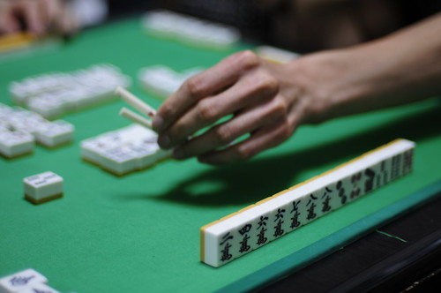
Mahjong – 3 times per week
1.30 – 3.30 - Mon – Wed – Sun
Beginners welcome to join at any or all sessions
Phone Anita 5328 4077 to organize or just turn up

Slide 34


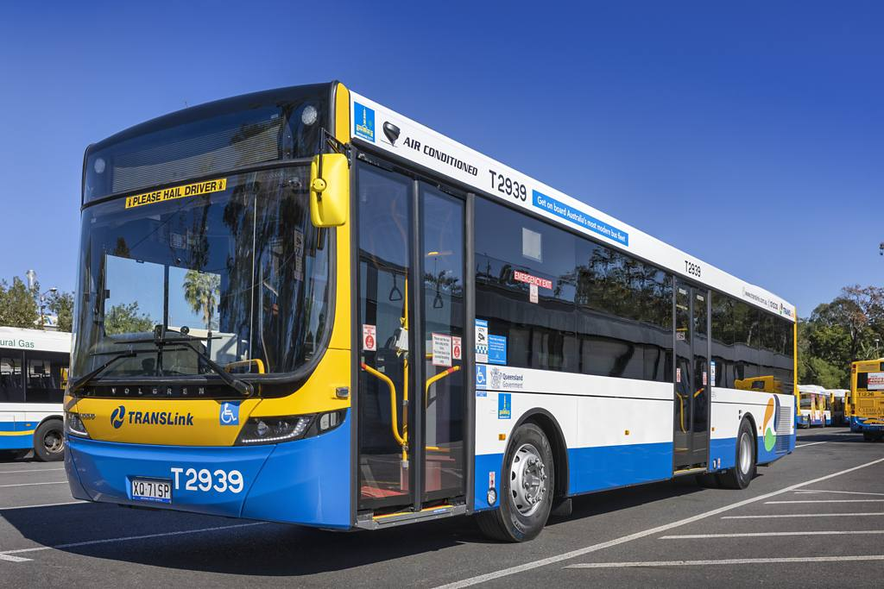
Bus to Gympie $1.00 return – part of Qld Gov initiative
8.00 am Leaves Dolphin Centre – Tin Can Bay – outside Vegie Shop
9.00 am 3 stops at Gympie
1. Library 2.Gympie Central 3. Cinemas (Goldfield Shopping Centre
If you get off at Cinemas you can walk Mary Street and get a free bus back from Brown Jug Café at 10.00 am or 12.00 noon to Gympie Central. Or just stay at the Cinemas or Gympie Central
Bus leaves Gympie Cinemas at 1.15 pm or Gympie Central at 1.25 pm and arrives back at Tin Can Bay at 2.30 pm at the Vegie Shop - Dolphin Centre
Bus Driver Trevor – lives in CWRV
Pls phone June or Bev if you would like to go with others and they can try to coordinate a day

Slide 35

“Cool Village” Social Darts
Dart Players - Amateurs and All levels welcome. Get a few together for a social game anytime.
Mixed, teams and male and female teams
Darts provided or BYO

Slide 36
Repeating Evening and Night Events – Free. Check special events and slides for any variations to the standard events
Monday | Tuesday | Wednesday | Thursday | Friday | Saturday | Sunday
 | 4.15 – 5.10 Water Aerobics (heated Pool) with Travis & 5.15 – 6.10 Water Aerobics – Heated Pool with Travis | 4.30 – 6.30 Happy Hour & Wine Club

Slide 37

POWER BALL SYNDICATE
“COOL VILLAGE PEOPLE”
Available for Residents Only
REGISTER AT Unit 76 (John and Marilyn). The syndicate numbers are limited. We have openings for a few more presently. Pls apply to Marilyn or John.
The main rule is that you are responsible to pay your weekly $5.00 contribution to the Syndicate. If you don’t pay you can’t win. Larger contributions can be paid in advance for several weeks if more convenient. These details are entered into a spreadsheet with individual accounts including winnings for good record keeping. Unit 76 (Marilyn) is the collection point. Call in most times or phone 0401 410 883 to make enquiries and arrangements. Winnings are distributed to individual accounts which can be collected or used for future games and which are being used to increase numbers of tickets for increased potential. Any large winnings will be distributed.
Recent Winnings:
7/8/2025 $51.26

Slide 38
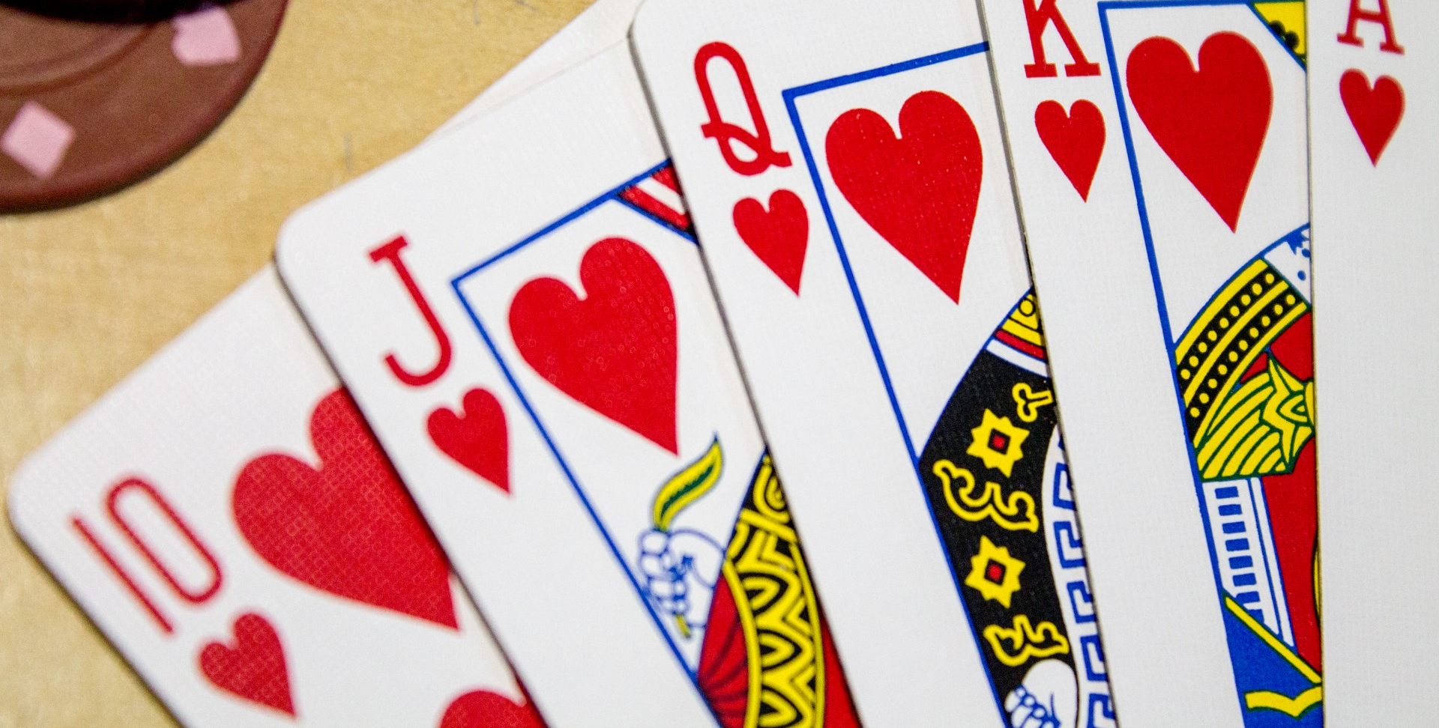
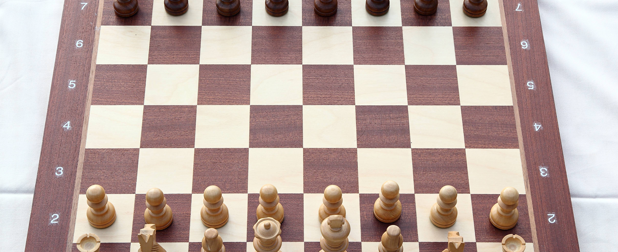
Cards and games
Wanted – Players
e.g. 500, Bridge, Canasta, Euchre, Uno, Poker or any favourite game etc
Scrabble, Chess, Dominos, Backgammon etc
Expressions of Interest please. Put your name, contact and suggestions etc in the club mailbox and let’s see if we can get some games and competition going. Pls nominate your preferred day and time.

Slide 39
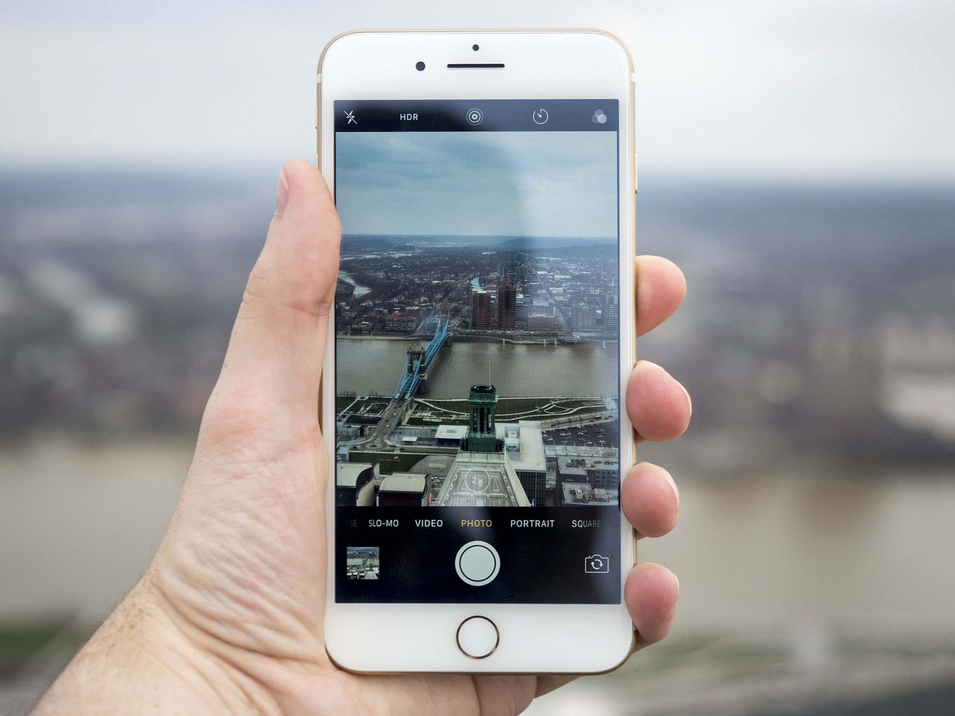
SLIDES UPDATED EVERY SUNDAY - ANY CHANGES, COMMENTS OR SUGGESTIONS PLEASE ADVISE MARILYN Unit 76
TO KEEP UP TO DATE YOU COULD
1. Take photos of interesting slides
2. Add interesting details in your Calendar whenever in club house over a coffee

